Slide 1
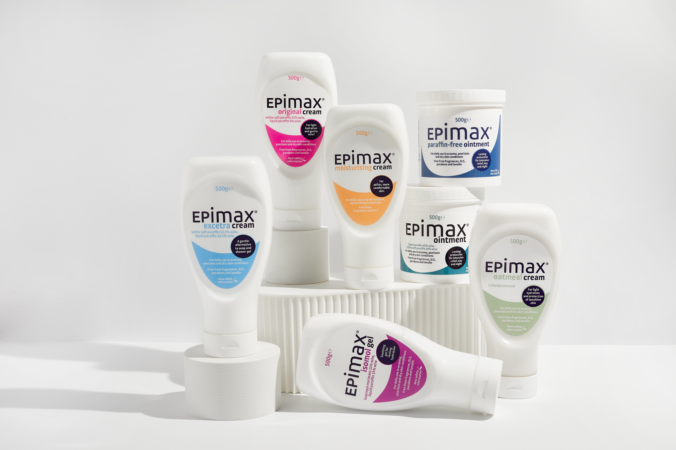
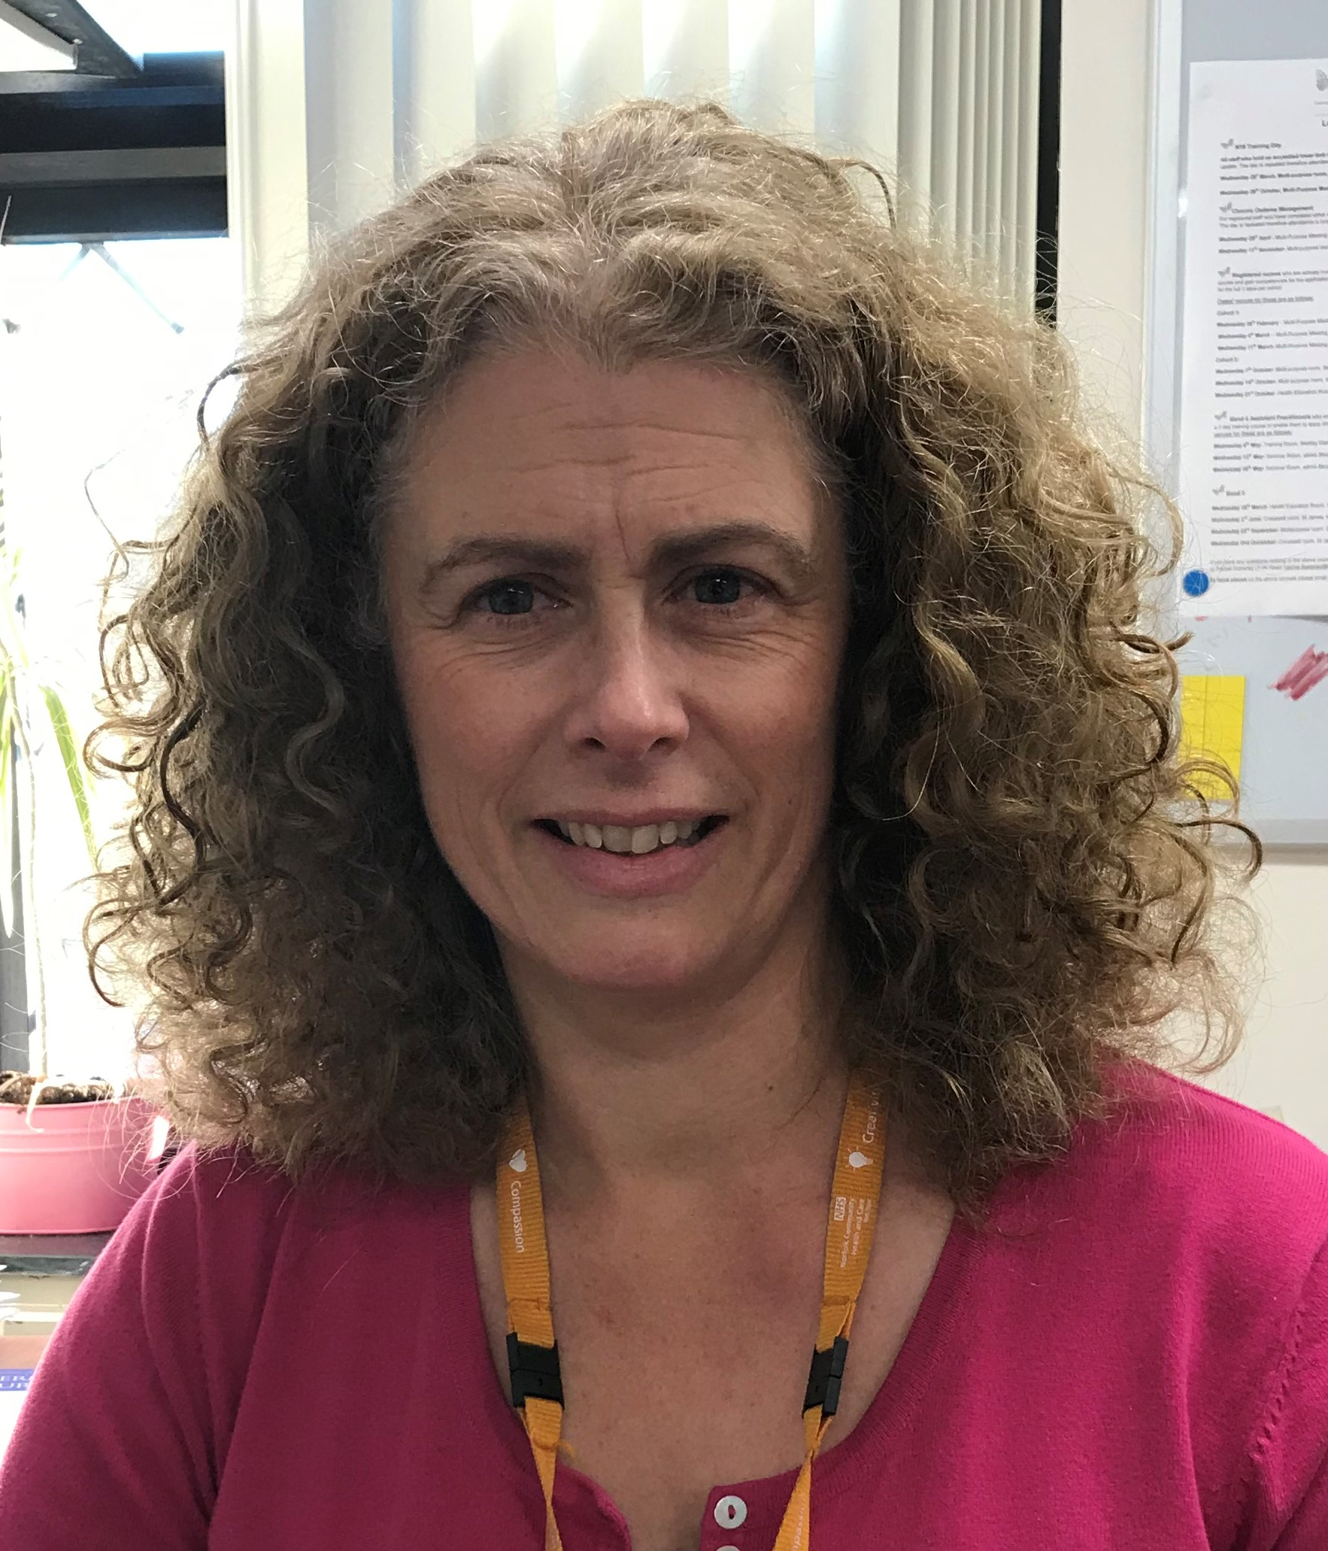
CARE FOR THE OLDER PERSON’S SKIN DURING THE WINTER MONTHS
WITH COMMUNITY DERMATOLOGY SPECIALIST NURSE, MS. SARA BURR
JOIN US FOR AN EDUCATIONAL WEBINAR
DATE WEDNESDAY 9TH NOVEMBER 2022
TIME 19:00 – 20:00
VENUE VIRTUAL
AGENDA
Sara Burr
Sara has over 25 years experience both in secondary care (having led an outpatient's department); and more recently in a community care setting, where she now leads a Skin Integrity Team in West Norfolk. The team compromises of dermatology, tissue viability, and lymphedema nurses. It aims to support patients and staff in thinking about the wider issues of maintaining good skin integrity.
Aetiology, treatment, and care of common skin conditions of the ageing skin
Emollients, appropriate formulations and best practice
BOOK YOUR PLACE
Please email Andrew to register for this event: Andrew.Stephenson@aspirepharma.co.uk
This meeting has been organised and funded by Aspire Pharma
10104511550 v 1.0 September 2022

