Slide 1
Services Workshop March 2022
David Dean CO
Kevin Barnes CSO

Slide 2
Agenda
Hypertension Case Finding Update
Overview
Who has signed up?
Next Steps?
Opportunity for GP Collaboration?
Smoking Cessation Update (Hospital Discharge Patients)
Overview
£1000 sign up fee
AOB
Q&A

Slide 3
Hypertension Case Finding Service
Finding those over 40 with Undiagnosed Hypertension
Initial Clinical BP check
24 hour testing depending on readings for the above
Sign up on MYS
A set-up fee of £440;
A fee for each BP check of £15; and
A fee for each ambulatory monitoring of £45.

Slide 4
Hypertension Case Finding Service
An incentive fee of £1,000 will be available if 5 ABPM intervention are provided in 2021/22;
Followed by a payment of £400 in the subsequent years if the pharmacy reaches the thresholds for those years (15 ABPM interventions will be required in 2022/23 and 20 in 2023/24).

Slide 5
BP Referrals from GP
If practices want to refer patients who have already been diagnosed with hypertension for blood pressure checks, then contractors should work with their practices to agree a local process by which this will work; there are no specific requirements set for this process and it could involve the practice agreeing that a specific list of patients can access the service or a cohort of patients could be specified.
General practices will also be able to refer patients requiring ABPM; in this scenario it is recommended that this referral is made electronically to the pharmacy.
Download a Microsoft Word practice referral template
Download a PDF practice referral template

Slide 6
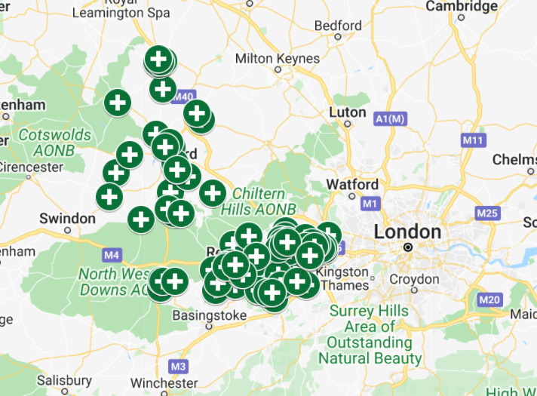
88 out of 258 Pharmacies have signed up so far
https://www.google.com/maps/d/u/0/edit?mid=1aZw0mZyjusj327RPtArae5MkoSZkKqIj&usp=sharing

Slide 7
Next Steps:

Slide 8
Hypertension Case Finding Activities for growing the service
Formulate a SMART action plan across the PCN
Speak with CD’s, GPs, Practice Pharmacists and CCG
Most practices are willing to work with us on this service – some need more prompting
Before big push with CD etc, start prompting within the pharmacy to
check processes,
staff understanding of the service and
get ‘word of mouth’ marketing working
Have a booking system in place

Slide 9
Hypertension Case Finding Activities for growing the service
Look at advertising
Word of mouth
Banners
Posters
Get your staff to promote the service (best option but can take the longest to be effective)
Messages on sales receipts
Flyers into prescription bags

Slide 10
Smoking Cessation Service (Hospital Discharge)
The SCS was added to the NHS Community Pharmacy Contractual Framework (CPCF) as part of Year 3 (2021/22) of the five-year CPCF deal.
Around 5.7 million people or nearly 14% of the adult population in England were reported to smoke in 2019. Smokers see their GP over a third more often than non-smokers, and smoking is linked to nearly half a million hospital admissions each year.
Notes:
Smoking rates have fallen significantly in the last 10 years, but smoking still accounts for more years of life lost than any other modifiable risk factor.
Around 5.7 million people or nearly 14% of the adult population in England were reported to smoke in 2019. Smokers see their GP over a third more often than non-smokers, and smoking is linked to nearly half a million hospital admissions each year.
The NHS Long Term Plan set a goal that by 2023/24, all people admitted to hospital who smoke will be offered NHS-funded tobacco treatment services. The plan committed to the adoption of the Ottawa Model for Smoking Cessation (OMSC), which has been evidenced across Canada to improve smoking quit rates by 11%.
As part of the OMSC, the smoking status of all admitted patients, is identified, followed by brief advice, personalised bedside counselling, timely nicotine replacement therapy and/or pharmacotherapy, and follow-up support for smoking cessation post-discharge.
To achieve successful smoking cessation, collaboration and an effective transfer of care are needed between secondary and primary care for all patients supported by the OMSC. Community pharmacy contractors have the potential to deliver this primary care smoking cessation support, and to be part of this wider aim for the NHS which will significantly benefit the patients referred.
Aim and objective of the SCS
The aim of the SCS is to reduce morbidity and mortality from smoking, and to reduce health inequalities associated with higher rates of smoking with the objective of the service being to ensure that any patients referred by NHS trusts to community pharmacy for the SCS receive a consistent and effective offer, in line with NICE guidelines and the OMSC.

Slide 11
Pharmacy Requirements
The service officially commences on 10th March 2022, which is the day after No Smoking Day; however, since this is an Advanced service, contractors are free to choose if they will provide the service and when they will start providing it.
The service must be provided by a pharmacist, due to the current rules on exemptions for VAT
To provide the service, contractors must have a carbon monoxide (CO) monitor (which is suitable for use with pregnant women) and sufficient disposable single patient use mouthpieces

Slide 12
Training Requirements
Read and understood the operational processes to provide the SCS as described in the service specification;
Successfully completed the following National Centre for Smoking Cessation and Training (NCSCT) courses and satisfactorily passed the assessments (where applicable):
Stop Smoking Practitioner training and certification;
Mental health and smoking cessation course; Pregnancy and smoking cessation course; and
E-cigarettes: a guide for healthcare professionals course.
Notes:
Pharmacists should also be aware of the availability of locally commissioned services and national support helplines/ groups; the Better Health quit smoking page includes information on getting daily email support, online communities and information on the National Smokefree Helpline.
Additional optional training
Pharmacists wanting to undertake further training on smoking cessation can do so on an optional basis to support their own continuing professional development (CPD).
The Centre for Pharmacy Postgraduate Education has additional learning and links to further reading, which pharmacists and other members of the team could consider accessing (please note, this is not a mandatory requirement for the service).
Pharmacy Team training
Although the service must be provided by the pharmacist, it is important that the wider pharmacy team are aware of the SCS and how it will operate. You could consider:
Holding a briefing session for your team;
Providing them with the one-page overview (please see below) on how the service will work;
Discussing as a team how you can work collectively to make the service a success; and
Making sure team members are clear on the daily activity required, such as checking for referrals, diary management, etc.
Download the PSNC Briefing for pharmacy teams on the service

Slide 13
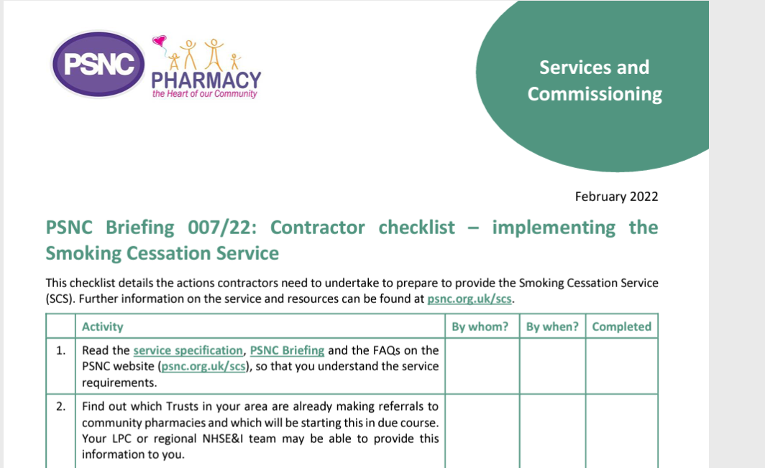

Slide 14
Inclusion criteria for the service
People aged 18 years and older who have started treatment for tobacco dependence in hospital and have chosen to continue their treatment in community pharmacy after discharge
This service does not exclude women who are pregnant or people who suffer from non-complex mental health problems although alternative local arrangements may already be in place for such people

Slide 15
Referrals
NHS trusts will identify patients who are smokers, provide a pre‑quit assessment, and start treatment. With consent, patients will be offered a referral to a pharmacy which is participating in the SCS (the patient will choose which pharmacy they wish to be referred to). The referral will be made using a secure electronic system or NHSmail following discharge from hospital.

Slide 16
Process
Contact patient within 5 days of referral
Record Consent
Conduct CO test
Provision of Behavioural Support
The pharmacy will supply a maximum of two weeks NRT at a time. As part of the consultation the suitability of the NRT should be reviewed and any changes agreed with the patient. The course length should not exceed 12 weeks treatment from the defined quit date. This includes any treatment supplied to the patient while in hospital and at the point of discharge.

Slide 17
Following a remote or face-to-face consultation, the pharmacist should use their professional judgement to determine whether they may supply NRT in accordance with the requirements of the Human Medicines Regulations and the service specification.
A quantity sufficient for a maximum of two week’s treatment should be supplied to coincide with the next appointment. The supply of NRT should be entered onto the Patient Medication Record (PMR) and the NRT supplied should be labelled.
The supply should be made free of charge to the patient; NHS prescription charges do not apply to these supplies.

Slide 18
Payment
A set-up fee of £1,000 (which will be paid following registration on MYS to provide the service, having declared the pharmacy is ready to provide the service
For each patient a fee for:
the first consultation of £30;
each interim consultation of £10; and
the last consultation of £40 (the last consultation may be at any point from and including the 4-week review up until the 12-week review).
Only the cost of medicines on the list of products which may be supplied as part of the service which is published in the Drug Tariff will be eligible for reimbursement.

Slide 19
AOB
Flu guidance now release
50-64 yr old (Healthy) no longer have access to NHS Flu Vaccine
Focus will be on HRG and Over 65s
UTI PGD in process of being signed off for East Berkshire
3 Local Authorities are currently speaking to LPC re New Contract (Reading, RBWM, Berkshire West)
DO NOT enter any contractual agreements with a LA/CCG/ICS unless you are sure the LPC has been consulted (check website)

Slide 20
Any Questions?

Slide 21
Thank You… Evening Events in Summer Training https://www.virtualoutcomes.co.uk/pharmacy-training/

