Slide 1


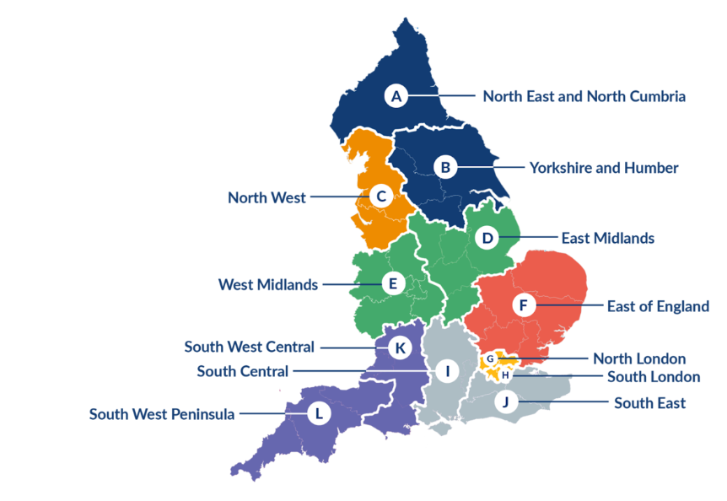
The NIHR HCP Launchpad Programme
The Academy of Research and Improvement within Hampshire and IOW Healthcare NHS Foundation Trust are managing the NIHR HCP Internship Programme for the South-Central Region
It is open to individual and team applications from registered HCPs* working in a diversity of NHS and non-NHS settings in this region
(*eligible list available here: Launchpad | The Academy of Research and Improvement)

Slide 2
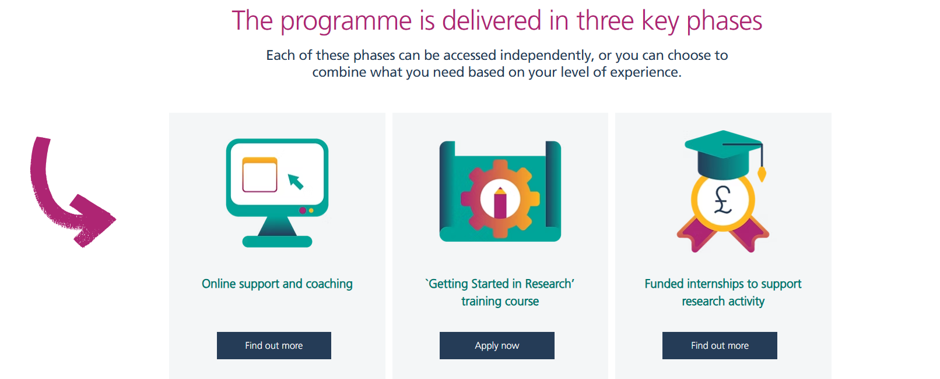

Slide 3
Online support | The Academy of Research and Improvement
Online drop-in sessions to support applicants, Aug 2026 onwards
Training course | The Academy of Research and Improvement
Optional, free, online 2-day course for applicants to explore research in healthcare and how they can build it into their careers
CLOSING DATE: 24th Sep @ midday
Dates: Oct 8th, Nov 5th 2026
Launchpad Internships | The Academy of Research and Improvement
Internship application window opens Nov 2026, until Jan 2027

Slide 4
Contact us
For more information, please visit: Launchpad | The Academy of Research and Improvement
Research and Improvement - HIOW
academy.hiowhealthcare.nhs.uk
hiowh.academy@nhs.net
Karen.evans95@nhs.net
@hiowhacademy
Academy of Research & Improvement

